Slide 1
Challenge 5
Group 5
Iris, Dave, Ray, Aaron, Shen

Slide 2
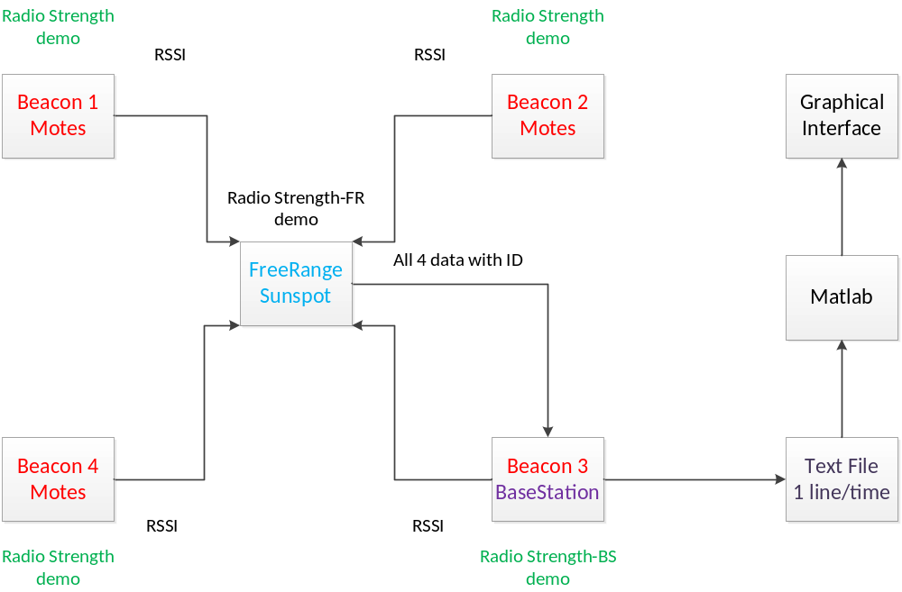
Architecture

Slide 3
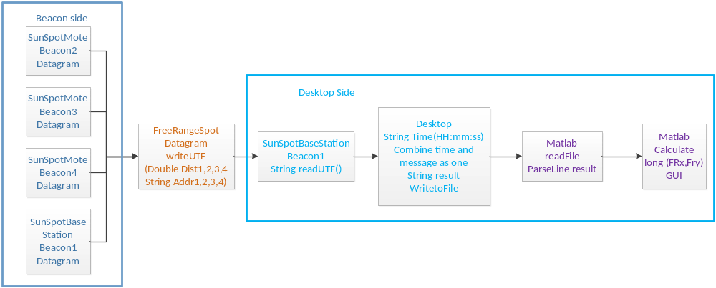
Data Flow

Slide 4
Demonstration
See on desktop.

